Slide 1
Computer Science 20
Looping – Self CHECK QUESTIONS

Slide 2
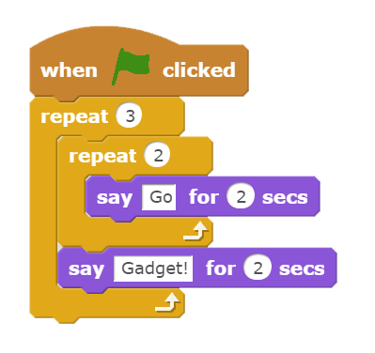
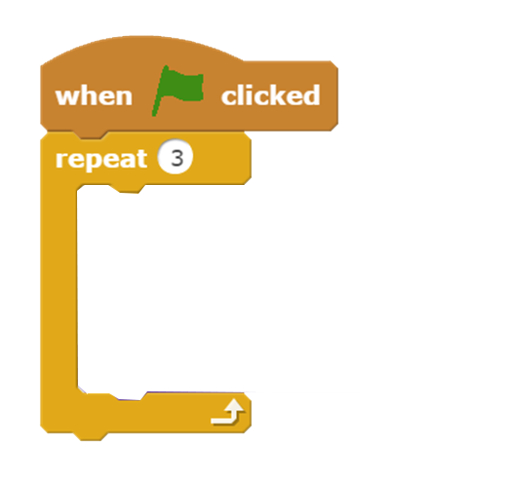
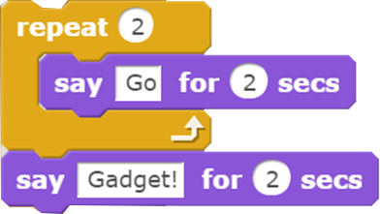
When the following script runs, how many times does the sprite say “Go”?

Slide 3
When the following script runs, how many times does the sprite say “Gadget!”?

Slide 4
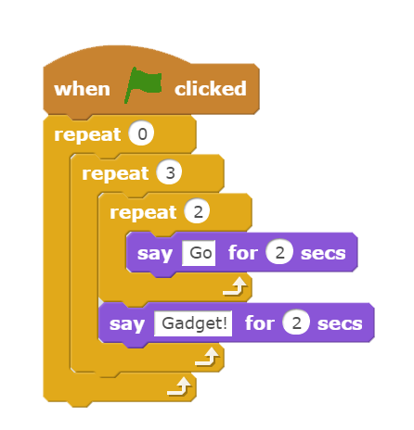
When the following script runs, how many times does the sprite say “Go!”?

Slide 5
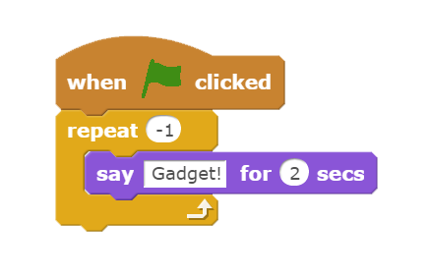
When the following script runs, how many times does the sprite say “Gadget!”?

